Slide 1

Real Estate based Recommendation System (Machine Learning)
MINI PROJECT (4-1)
MID-TERM PRESENTATION
Guide name: Prof. Bhakti Paranjape
Batch Coordinator: Prof. Shamla Mantri

Slide 2
MACHINE LEARNING:
Arthur Samuel (1959). Machine Learning: Field of study that gives computers the ability to learn without being explicitly programmed.
Tom Mitchell (1998) Well-posed Learning Problem: A computer program is said to learn from experience E with respect to some task T and some performance measure P, if its performance on T, as measured by P, improves with experience E.
Suppose your email program watches which emails you do or do not mark as spam, and based on that learns how to better filter spam. What is the task T in this setting?
Classifying emails as spam or not spam.
Watching you label emails as spam or not spam.
The number (or fraction) of emails correctly classified as spam/not spam.

Slide 3
Machine Learning
Supervised
Regression
Classification
Unsupervised
Clustering
Dimension Reduction
Reinforcement
Model free
Model based

Slide 4
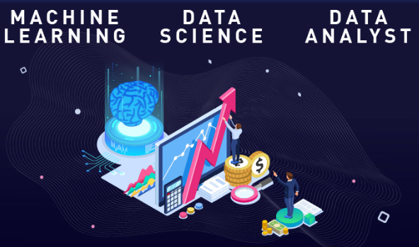
DATA SCIENCE
Data science is a broad term for multiple disciplines, machine learning fits within data science.
The main difference between the two is that data science as a broader term not only focuses on algorithms and statistics but also takes care of the entire data processing methodology.
Data science, data analytics, and machine learning are some of the most in-demand domains in the industry right now.

Slide 5
RECOMMENDATION SYSTEMS:
Recommendation Systems are composed by algorithms that generate recommendations of a given type of item for users based on the information they provide
Recommender engines (REs) also known as recommender systems are software tools and techniques providing suggestions to a user.
Recommendation Systems
Content-Based Filtering
Collaborative Based Filtering

Slide 6
INTRODUCTION:
This project outlines how the Recommendation System for Real Estate Project will address current real estate platform which has become a major priority for buyers & sellers.
The project will compare and evaluate the results from two training models i.e. Decision Tree and Random Forest to predict the price.
The motivation behind is to show how a recommender system can be applied in Real estate scenario.
The main contributions of this project can be summarized as follow:
To analyze data of the real estate from the dataset
To evaluate and predict the results by using training models (Decision Tree and Random Forest)
To recommend the sectors of real estate based on data and compare the results.

Slide 7



SOFTWARE USED:
Libraries used

Slide 8
DECISION TREE
Training Models
Decision Tree
Random Forest
Decision trees are constructed via an algorithmic approach that identifies ways to split a data set based on different conditions. It is one of the most widely used and practical methods for supervised learning.
Decision Trees are a non-parametric supervised learning method used for both classification and regression tasks.
RANDOM FOREST
Random forest, like its name implies, consists of a large number of individual decision trees that operate as an ensemble.
Each individual tree in the random forest spits out a class prediction and the class with the most votes becomes our model’s prediction

Slide 9
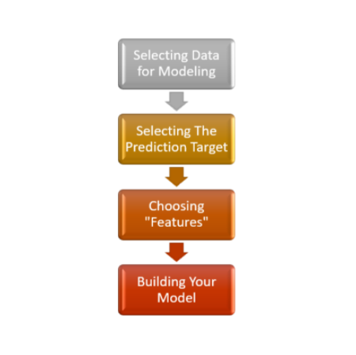
BLOCK SCHEMATIC:

Slide 10
PROCESS METHODOLOGY
1. Import data from the dataset
2. Read the data and store data in DataFrame
3. Choose variables/columns, with the columns property of the DataFrame
4. Use the dot notation to select the column we want to predict
5. Select multiple features by providing a list of column names
6. Use the scikit-learn library to create your models.
7. Define a decision tree model and a Random Forest with scikit-learn and fitting it
with the features and target variable.

Slide 11
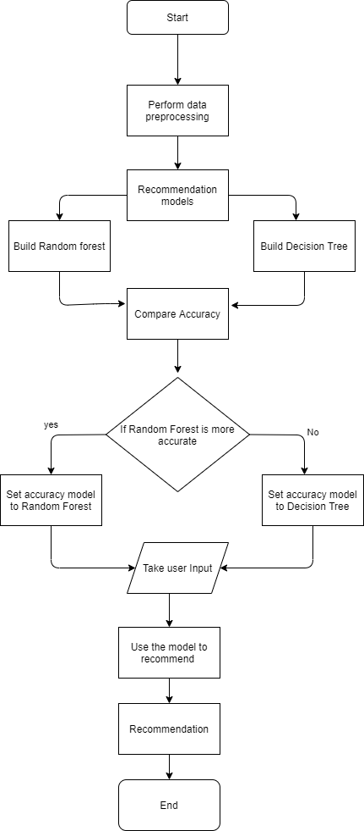
FLOWCHART

Slide 12
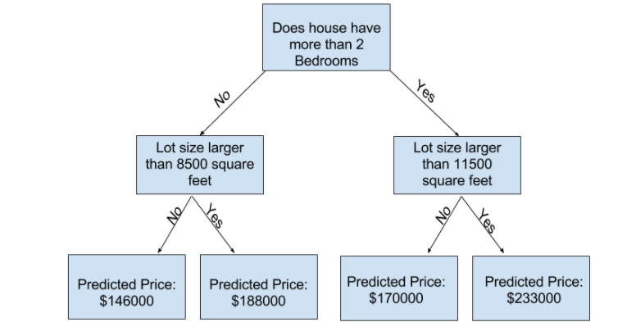
DECISION TREE FLOWCHART

Slide 13
Train_X
Train_y
FEATURES
PRICE
TRAINING MODEL
70%
Val_X
Val_y
TESTING MODEL
30%
TRAINED MODEL
Predictions_y
DATASET

Slide 14
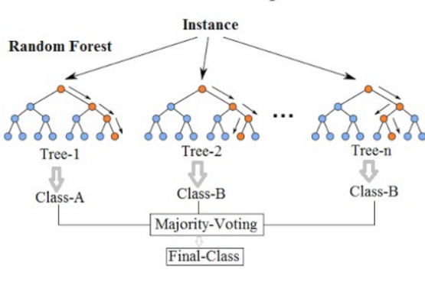
RANDOM FOREST FLOWCHART

Slide 15
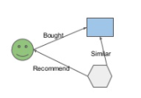
ADVANTAGES OF RECOMMENDER SYSTEMS
A recommendation system uses data analysis techniques to figure out the items that match the users' taste & preferences.
The ultimate aim of any recommendation engine is to stimulate demand and engage users.
Recommendation engines can have many use cases like in entertainment, e-commerce, mobile apps, education, etc.

Slide 16
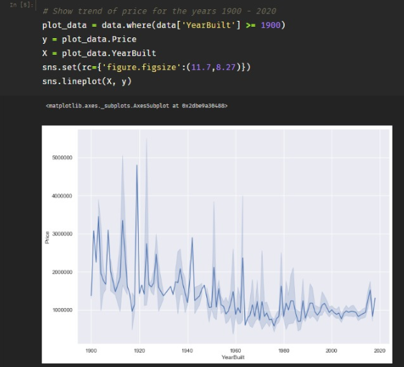
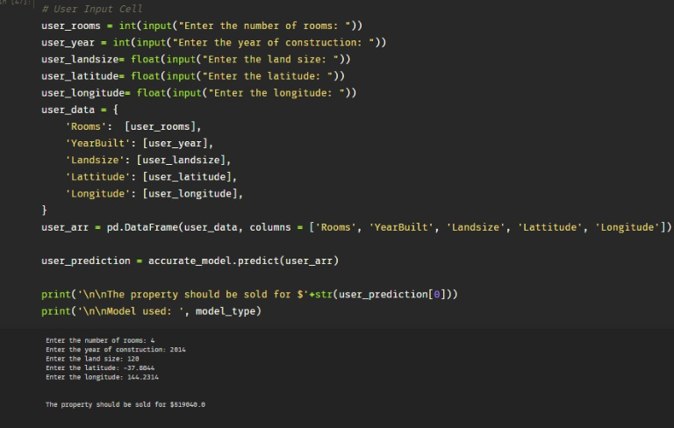
RESULTS

Slide 17
CONCLUSION
Project has been developed successfully.
Throughout this project I have explored the possibility of integrating a recommender system by using Machine learning concepts.
In this project I have used two training models decision tree and Random Forest to implement and recommend the price of the real-estate system by extracting the features from the dataset.

Slide 18
THANK YOU!
Sanskruti raut (ECE14)
Final year ece-c

